Slide 1
American Jewry:
Challenging the Narratives
Leonard Saxe, Ph.D.
Theodore Sasson, Ph.D.
21 June 2016

Slide 2
Changing Narrative # 1
Conventional Wisdom:
“The American Jewish population is shrinking.”
Reality:
American Jewish population – including those who identify “by religion” and “not by religion” – is increasing

Slide 3
Growth of US Jewry:
Jews by religion/not by religion and children
Jewish Children
Adult Jews not by Religion (JNR)
Adult Jews by Religion (JBR)

Slide 4
Why is U.S. Jewry expanding?
Immigration
  FSU (c. 10% of the U.S. Jewish population)
  Israel, South America, Canada
Increase in Jewish identification
  Expanded /improved formal and informal education
  Easier to be ethnic/Jewish
Intermarriage
  Change in Attitudes/Welcoming-Patrilineal descent
  More children being raised as Jews

Slide 5
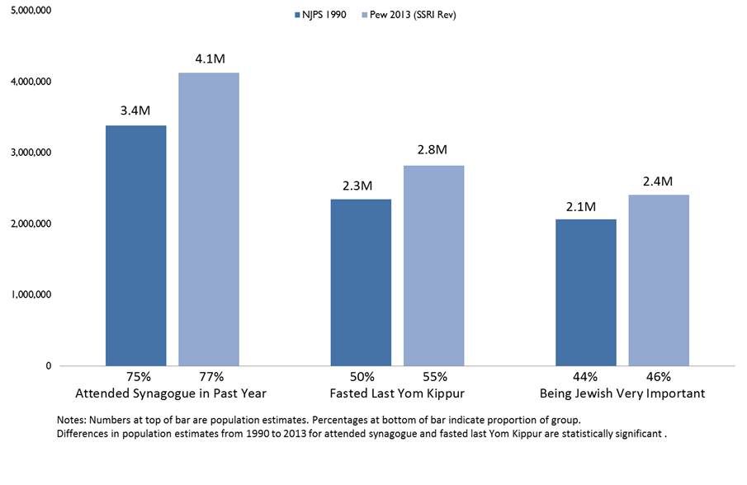
Jewish Behaviors and Attitudes:
1990 v. 2013
2013 Source: Pew Research Center 2013 Survey of U.S. Jews, Feb. 20-June 13, 2013.

Slide 6
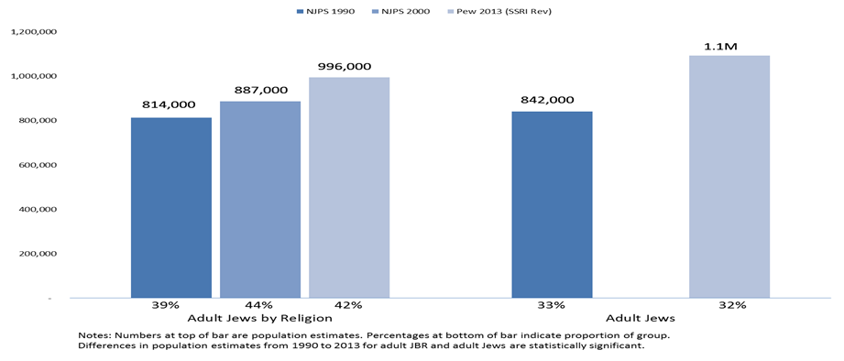
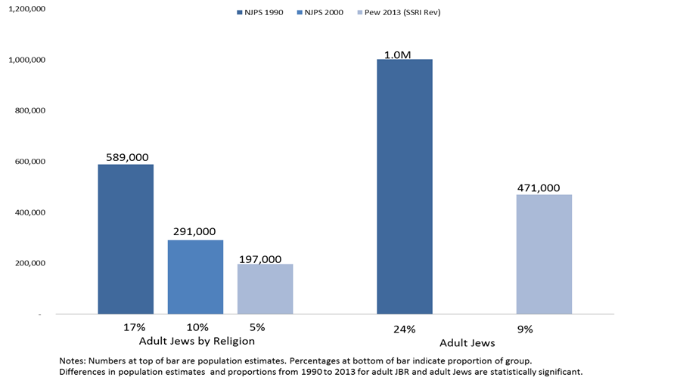
Household Synagogue Membership:
1990 v. 2013
2013 Source: Pew Research Center 2013 Survey of U.S. Jews, Feb. 20-June 13, 2013.

Slide 7
Changing Narrative # 2
Conventional Wisdom:
“Intermarriage leads to population loss.”
Reality:
The consequences of intermarriage for Jewish continuity are changing.

Slide 8
Jewish Education of Adults with Intermarried Parents
(Pew 2013)
Note: Difference in proportions between millennial and silent generations are statistically significant.
Source: Pew Research Center 2013 Survey of U.S. Jews, Feb. 20-June 13, 2013.

Slide 9
Jewish Identification of Adults with Intermarried Parents (Pew 2013)
Note: Difference in proportions between millennial and silent generations for JBR are statistically significant.
Source: Pew Research Center 2013 Survey of U.S. Jews, Feb. 20-June 13, 2013.

Slide 10
2015 Brandeis-CMJS Study of Millennials
Survey of 2009-14 Birthright Israel applicants, ages 19-32
~2700 respondents, including mix of children of intermarriage and inmarriage
Jewish background of sample population looks like broader population, with modest differences

Slide 11
Adult Children of In/Intermarriage:
Special meal on Shabbat
Inmarried Parents
Intermarried Parents
Inmarried Parents
Intermarried Parents
Inmarried Parents
Intermarried Parents
No college Jewish experiences
Birthright only
Birthright + Course + Group
Source: CMJS Millennial generation study (2015). Predictive margins from a logistic regression model.

Slide 12
Adult Children of In/Intermarriage:
Jewish identity
Inmarried Parents
Intermarried Parents
Inmarried Parents
Intermarried Parents
Inmarried Parents
Intermarried Parents
No college Jewish experiences
Birthright only
Birthright + Course + Group
Predictive margins from a logistic regression model.

Slide 13
Adult Children of In/Intermarriage:
Importance of raising children Jewish
Inmarried Parents
Intermarried Parents
Inmarried Parents
Intermarried Parents
Inmarried Parents
Intermarried Parents
No college Jewish experiences
Birthright only
Group + Course + Birthright

Slide 14
Challenging the Narrative # 3
Conventional Wisdom: “BDS is sweeping American campuses, causing widespread antisemitism”
Reality:
At present, BDS activity is a major issue only on some campuses and it is not deterring Jewish students’ engagement with Israel

Slide 15
Hostile Environment toward Israel on Campus
Source: Study of BRI undergraduate applicants at 50 US universities, CMJS 2016

Slide 16
Hostile Environment toward Jews on Campus
Source: Study of BRI undergraduate applicants at 50 US universities, CMJS 2016

Slide 17
Comfortable Expressing Opinion on Israeli-Palestinian Conflict
Source: Study of BRI undergraduate applicants at 50 US universities, CMJS 2016

Slide 18
Perceiving a Hostile Environment to Israel and Connection to Israel
10 Most Hostile vs. 10 Least Hostile, Participants vs. Non-Participants
Agrees to "Campus has a hostile environment to Israel"
Somewhat/Very much Connected to Israel
Source: Study of BRI undergraduate applicants at 50 US universities, CMJS 2016

Slide 19
Changing Narrative #4
Conventional Wisdom:
“American Jews are distancing from Israel”
Reality:
For now, American Jews remain strongly connected to Israel

Slide 20
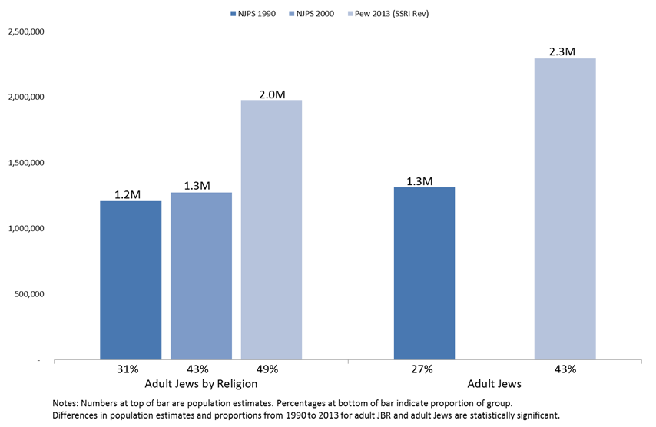
Israel Visits: 1990, 2000 v. 2013
2013 Source: Pew Research Center 2013 Survey of U.S. Jews, Feb. 20-June 13, 2013.

Slide 21
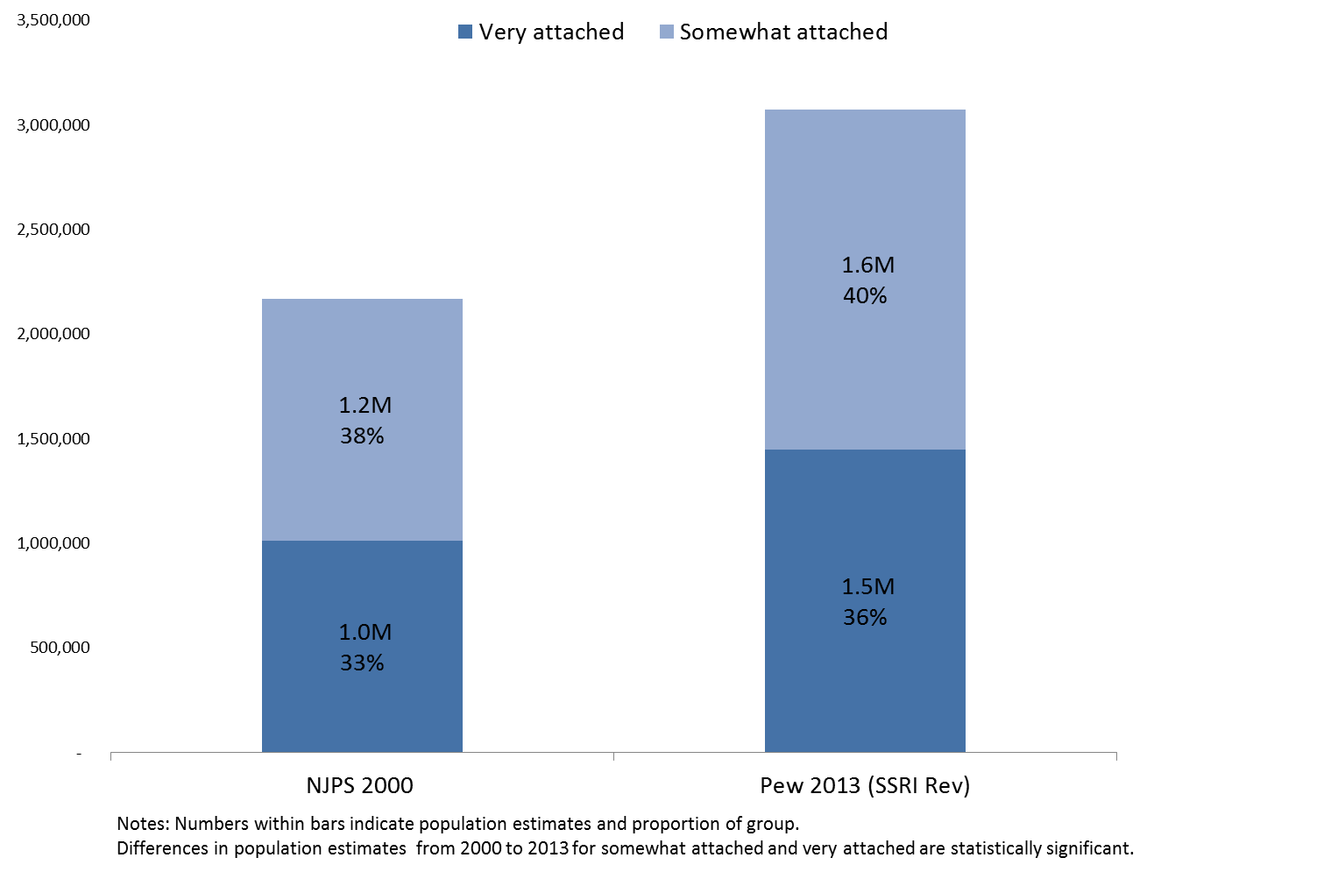
Israel Attachment: 2000 v. 2013 (Jews by religion)

Slide 22
Emotional Attachment to Israel by Parental Marriage
Millennials Only (Pew 2013)

Slide 23
Emotional Attachment to Israel by Political Orientation
Millennials Only (Pew 2013)

Slide 24
Long term impact: Connection to Israel
(2007-2009 applicants)
Nonparticipants
Participants
Nonparticipants
Participants
Parents intermarried
Parents inmarried
Source: Jewish Futures Project W5 (2015), Preliminary findings

Slide 25
Long term impact: Probability of having a Jewish spouse
(2001-2006 applicants)
Nonparticipants
Participants
Participants
Nonparticipants Participants
Overall
Parents intermarried
Parents inmarried
Source: Jewish Futures Project W5 (2015), Preliminary findings

Slide 26
To be continued…
תודה רבה
Len Saxe saxe@brandeis.edu | Ted Sasson sassont@brandeis.edu

